Slide 1




ASSOCIATION RULES MARKET BASKET ANALYSIS

Slide 2
Introduction to Market Basket Analysis
The most widely used area of application for association rules is Market Basket Analysis
It is used to analyze the customer purchasing behavior and helps in increasing the sales and maintain inventory by focusing on the point of sale transaction data
Market Basket Analysis (Association Analysis) is a mathematical modeling technique based upon the theory that if you buy a certain group of items, you are likely to buy another group of items

Slide 3
Definitions and Terminology
Term | Definition
Transactions | A set of items (Item set)
Support | Ratio of number of times two or more items occur together to the total number of transactions Support can be thought of as P(A and B)
Confidence | Conditional probability that a randomly selected transaction will include Item B given Item A P(B|A) (written as A => B)
Lift | Ratio of the probability of Items A and B occurring together (Joint probability) to the product of P(A) and P(B)

Slide 4
Rule Evaluation – Support
Transaction No. | Item 1 | Item 2 | Item 3 | …
100 | Beer | Diaper | Chocolate
101 | Milk | Chocolate | Shampoo
102 | Beer | Wine | Vodka
103 | Beer | Cheese | Diaper
104 | Ice Cream | Diaper | Beer
A B
Support of {Diaper, Beer}
Support of {Diaper, Beer} is 3/5

Slide 5
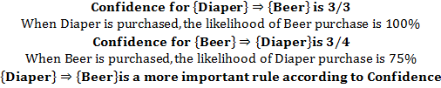
Rule Evaluation – Confidence
Transaction No. | Item 1 | Item 2 | Item 3 | …
100 | Beer | Diaper | Chocolate
101 | Milk | Chocolate | Shampoo
102 | Beer | Wine | Vodka
103 | Beer | Cheese | Diaper
104 | Ice Cream | Diaper | Beer

Slide 6

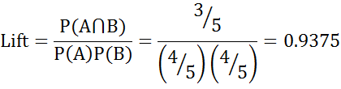
Rule Evaluation – Lift
Transaction No. | Item 1 | Item 2 | Item 3 | Item 4
100 | Beer | Diaper | Chocolate
101 | Milk | Chocolate | Shampoo
102 | Beer | Milk | Vodka | Chocolate
103 | Beer | Milk | Diaper | Chocolate
104 | Milk | Diaper | Beer
A B
Lift < 1 indicates Chocolate is decreasing the chance of Milk purchase

Slide 7
Using MBA for Recommendations
Support can be used for initial recommendations or to determine the layout of the catalog of an ecommerce site
Confidence can be used to provide recommendations based on first product purchase.
Use rules only if lift is greater than one.

Slide 8
Case Study
Background
Objective
Available Information
Transactions data collected from point of sales is generally in long format. Arules package requires the data to be in wide format.
To convert available data to a format suitable for association analysis and conduct analysis via arules package in R
Each transaction is given a unique ID
Items basket contains five items, items purchased during each transaction are recorded

Slide 9
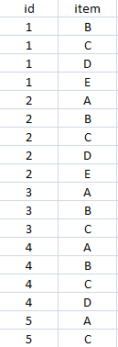
Data Snapshot
Transactions Data for MBA
Columns | Description | Measurement | Possible values
id | Transaction Id | - | Positive Integers
item | Items purchased | A,B,C,D,E | 5

Slide 10
Data Conversion
#Convert the Data
library(arules) trans<-read.transactions("Transactions Data for MBA.csv",format="single",sep=",",cols=c("id","item"),header=TRUE)
read.transactions() in package arules reads a transactions data file and creates a
transaction object.
format= indicates the format of the dataset. "single" implies each line
corresponds to a single item, containing at least ids for the transaction and the
item. "basket“ implies each line in the transaction data file represents a
transaction where the items (item labels) are separated by the characters specified
by sep.
For the "single" format, cols= is a numeric or character vector of length
two giving the numbers or names of the columns (fields) with the transaction and
item ids, respectively.
sep= is a character string specifying how fields are separated in the data file. The
default ("") splits at whitespaces.

Slide 11
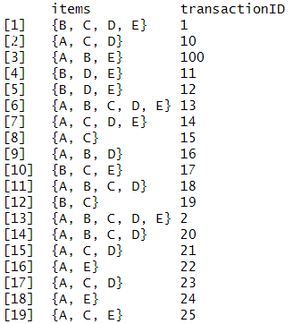
Data Conversion
#The converted data looks as follows:
inspect(trans)

Slide 12
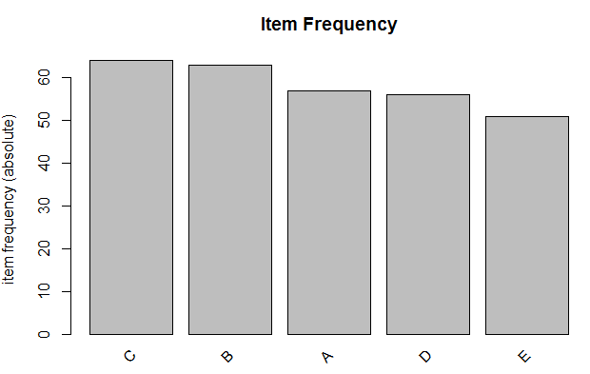
Association Analysis
#Visualise Frequency
itemFrequencyPlot(trans,topN=5,type="absolute")
itemFrequencyPlot() calculates item frequency and returns a barplot.
topN= instructs R to plot only top N highest item frequency or lift
type= is a character string indicating whether item frequencies should
be displayed relative or absolute.
# Output
Interpretation:
The plot shows items by frequency in a descending order.

Slide 13
Association Analysis
#Get the Rules
rules<-apriori(trans,parameter=list(supp=0.001,conf=0.8)) inspect(rules[1:5])
apriori() is used to mine frequent itemsets, association rules or
association hyperedges using this algorithm with specified support
and confidence
inspect() in package arules displays association and additional
information formatted for online inspection

Slide 14
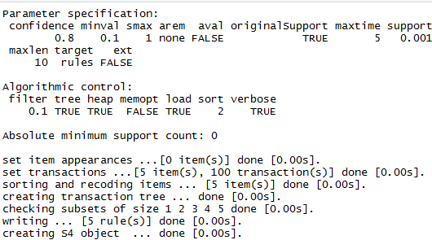
Association Analysis
# Output
Interpretation:
The output displays parameter specification, algorithmic control and absolute minimum
support count.
It also lists down tasks performed and time taken to complete them.
We are interested in knowing how many rules are created; Here 5 rules are created.

Slide 15
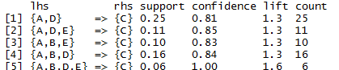
Association Analysis
# Output
Interpretation:
inspect() returns list of lhs and rhs items, their support, confidence and lift values
Questions: 1) Find rules any with confidence=1
2) Find top 3 rules based on highest Lift

Slide 16
THANK YOU!!

